Slide 1
SUPPLY
In a market economy, sellers for products and services constitute the supply side.
As the term ‘demand’ refers to the quantity of a good or service that the consumers are willing and able to purchase at various prices during a given period of time.
The term ‘supply’ refers to the amount of a good or service that the producers are willing and able to offer to the market at various prices during a given period of time.

Slide 2
Two important points apply to supply:
Supply refers to what a firm offer for sale in the market, not necessarily to what they succeed in selling. What is offered may not get sold.
Supply is a flow. The quantity supplied is ‘so much’ per unit of time, per day, per week, or per year.

Slide 3
DETERMINANTS OF SUPPLY
Although price is an important consideration in determining the willingness and desire to part with commodities, there are many other factors which determine the supply of a product or a service. These are discussed below:
Price of the good: Other things being equal, the higher the relative price of a good the greater the quantity of it that will be supplied. This is because goods and services are produced by the firm in order to earn profits and, profits rise if the price of its product rises.

Slide 4
(ii) Prices of related goods:
If the prices of other goods rise, they become relatively more profitable to the firm to produce and sell than the good in question.
It implies that, if the price of Y rises, the quantity supplied of X will fall.
For example, if price of wheat rises, the farmers may shift their land to wheat production away from corn and soya beans.

Slide 5
(iii) Prices of factors of production:
Cost of production is a significant factor that affects supply. A rise in the price of a particular factor of production will cause an increase in the cost of making those goods that use a great deal of that factor than in the costs of producing those that use relatively small amount of the factor.
For example, a rise in the cost of land will have a large effect on the cost of producing wheat and a very small effect on the cost of producing automobiles.
Thus, a change in the price of one factor of production will cause changes in the relative profitability of different lines of production and will cause producers to shift from one line to another and thus supplies of different commodities will change.

Slide 6
(iv) State of technology:
The supply of a particular product depends upon the state of technology also.
Inventions and innovations tend to make it possible to produce more or better goods with the same resources, and thus they tend to increase the quantity supplied of some products and to reduce the quantity supplied of products that are displaced. Availability of spare production capacity and the ease with which factor substitution can be made and the cost of such substitution also determine supply.

Slide 7
(v) Government Policy:
The production of a good may be subject to the imposition of commodity taxes such as excise duty, sales tax and import duties. These raise the cost of production and so the quantity supplied of a good would
Subsidies, on the other hand, reduce the cost of production and thus provide an incentive to the firm to increase supply.
When government imposes restrictions such as import quota on inputs, rationing of input supply etc, production tends to fall.

Slide 8
(vi) Nature of competition and size of industry:
Under competitive conditions, supply will be more than that under monopolized conditions. If there are large number of firms in the market, supply will be more.
Besides, entry of new firms, either domestic or foreign, causes the industry supply curve to shift rightwards.
Other Factors: The quantity supplied of a good also depends upon government’s industrial and foreign policies, goals of the firm, infrastructural facilities, natural factors such as weather, floods, earthquake and man-made factors such as war, labour strikes, communal riots etc.

Slide 9
LAW OF SUPPLY
Other things remaining constant, the quantity of a good produced and offered for sale will increase as the price of the good rises and decrease as the price falls. This law is based upon common sense, because the higher the price of the good, the greater the profits that can be earned and thus greater the incentives to produce the good and offer it for sale.

Slide 10
The law of supply can be explained through a supply schedule and a supply curve. A supply schedule is the tabular presentation of the law of supply.
Table 9 : Supply Schedule of Good ‘X’
Price (Rs) (per kg) | Quantity supplied (kg)
1 | 5
2 | 35
3 | 45
4 | 55
5 | 65

Slide 11
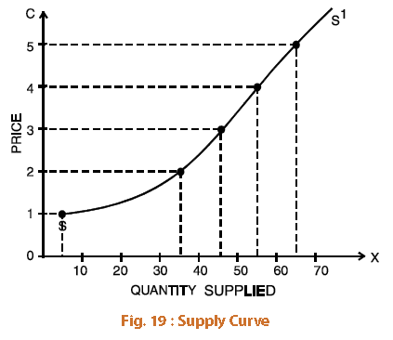

Slide 12
The market supply, like market demand, is the sum of supplies of a commodity made by all individual firms or their supply agencies.
The market supply is governed by the law of supply. The market supply curve for ‘X’ can be obtained by adding horizontally the supply curves of various firms.

Slide 13
ELASTICITY OF SUPPLY
The elasticity of supply is defined as the responsiveness of the quantity supplied of a good to a change in its price.
Elasticity of supply is measured by dividing the percentage change in quantity supplied of a good by the percentage change in its price i.e.,
Percentage change in quantity supplied
Ei = -------------------------------------------------------
Percentage change in Price
Change in quantity supplied /quantity supplied
= -------------------------------------------------------------------
Change in price /price

Slide 14
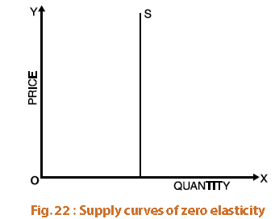
Type of Supply Elasticity
(i) Perfectly inelastic supply: If as a result of a change in price, the quantity supplied of a good remains unchanged, we say that the elasticity of supply is zero or the good has perfectly inelastic supply. The vertical supply curve in Figure 22 shows that irrespective of price change, the quantity supplied remains unchanged.

Slide 15
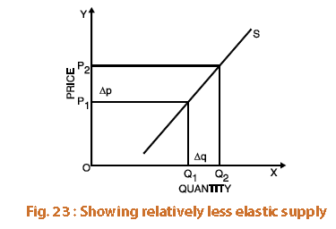
(ii) Relatively less-elastic supply: If as a result of a change in the price of a good its supply changes less than proportionately, we say that the supply of the good is relatively less elastic or elasticity of supply is less than one. Figure 23 shows that the relative change in the quantity supplied (Δq) is less than the relative change in the price (Δp).

Slide 16
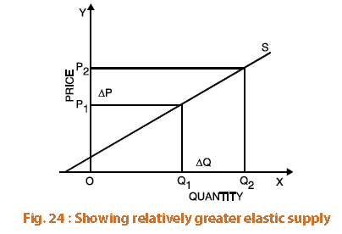
(iii) Relatively greater-elastic supply: If elasticity of supply is greater than one i.e., when the quantity supplied of a good changes substantially in response to a small change in the price of the good we say that supply is relatively elastic. Figure 24, shows that the relative change in the quantity supplied (Δq) is greater than the relative change in the price

Slide 17
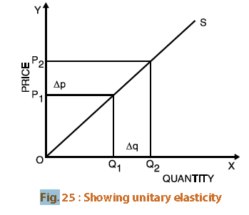
(iv) Unit-elastic: If the relative change in the quantity supplied is exactly equal to the relative change in the price, the supply is said to be unitary elastic. Here the coffiecient of elasticity of supply is equal to one. In Figure 25, the relative change in the quantity supplied (Δq) is equal to the relative change in the price (Δp).

Slide 18
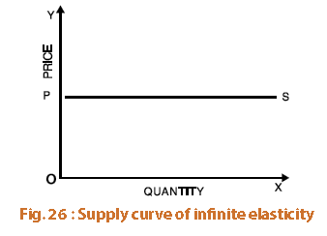
(v) Perfectly elastic supply: Elasticity of supply said to be infinite when nothing is supplied at a lower price, but a small increase in price causes supply to rise from zero to an infinitely large amount indicating that producers will supply any quantity demanded at that price.

Slide 19
Measurement of supply-elasticity
The elasticity of supply can be considered with reference to a given point on the supply curve or between two points on the supply curve.
When elasticity is measured at a given point on the supply curve, it is called point elasticity. Just as in demand, point-elasticity of supply can be measured with the help of the following formula:
dq p
Es= ---- × -----
dp q
Where dq /dp is differentiation of the supply function with respect to price and p and q refer to price and quantity respectively.

Slide 20
Arc-Elasticity:
Arc-elasticity i.e. elasticity of supply between two prices can be found out with the help of the following formula:
q1 – q2 p1 - p2
Ep = -----------/------------
q1 + q2 p1 + p2
OR
q1 – q2 p1 + p2
Ep = ----------- × ------------
q1 + q2 p1 - p2

Slide 21
Equilibrium Price
Equilibrium refers to a market situation where quantity demanded is equal to quantity supplied.
The intersection of demand and supply determines the equilibrium price. At this price the amount that the buyers want to buy is equal to the amount that sellers want to sell.
Only at the equilibrium price, both the buyers and sellers are satisfied.
Equilibrium price is also called market clearing price. The determination of market price is the central theme of micro economic analysis. Hence, micro-economic theory is also called price theory.

Slide 22
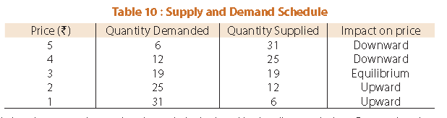
The following table explains the equilibrium price

Slide 23
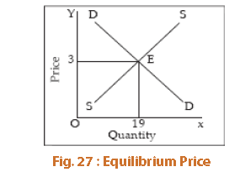
The equilibrium price is determined by the intersection between demand and supply. It is also called the market equilibrium.

